Slide 1
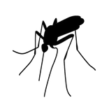
West Nile Virus Prediction
Jerd Phichitkul

Slide 2

Background
Chicago Department of Public Health (CDPH)
Mosquitos are main carrier of West Nile Virus
Chicago wants to know where to spray, based on traps

Slide 3
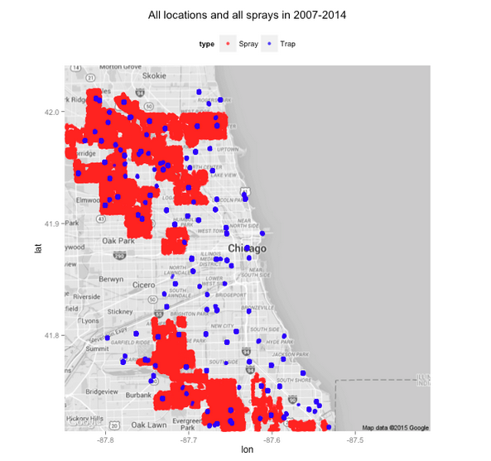
Data
Mapdata
Train.csv
Weather.csv
Spray.csv
Test.csv
Hypothesis: Temperature
Moisture

Slide 4
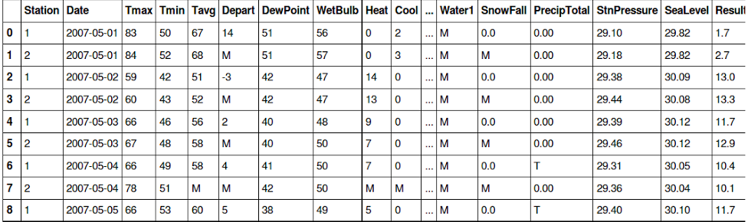
Data Munging Steps
Visualization
Eliminate Na
Initially ran PCA
Feature Extraction (Spray)

Slide 5
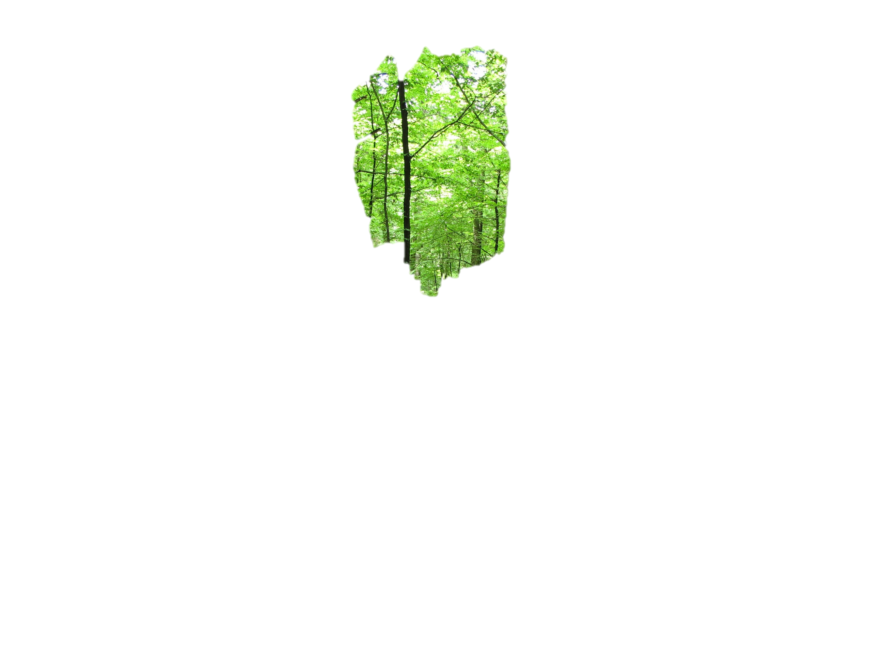
Models Used
Logistic Regression
Random Forest
Knn Classifier

Slide 6
Outcome

Slide 7
 | Logistic Regression | Random Forest | KNN
PCA, Rows | %55.47 | %62.82 | -
PCA, Columns | - | %62.71 | -
Columns | %63.3 | %66.07 | -
Columns, Double Data | - | %68.8 | %60.25
Best model is 68.8% Accuracy, Leader Model~84%
Dry and Hot Weather?
Location (Latitude, Longitude, Block) and Species

Slide 8
What did not work out?
Overly selective of features (pca, data that weren’t in the test set),
Spent too much time with not so useful data
Random forest not logistic regression, or KNN

Slide 9
Important Observation
Generalization not accuracy is the key (64%)
More Data is better!
Always Iterate!!

Slide 10
Future Work
More Location Data (convert all categorical location to numerical!)
More Data in general! (Dates)
Extracting Spray features
Turning knobs
Generalized Additive Models (GAM)
Research Papers

